Slide 1
Velocity

Slide 2
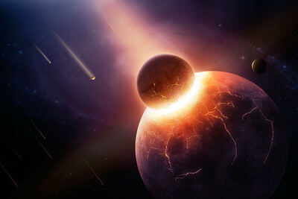
Welcome to this Smart Lesson on velocity!
After completing this Smart Lesson you will be able to:
State the velocity of an object.
Subtract vectors.
Calculate the velocity of an object relative to an observer.
Calculate relative velocity in two dimensions.

Slide 3

In this lesson we will be learning about velocity in the context of a tournament.
A tournament is a competition or pretend fight between medieval warriors.
Tournaments were held primarily for entertainment. The most popular event was the melee, where participating knights would be divided into two groups. The two groups would crash together on horseback in an attempt to break the other formation, or push them back.
In this lesson we will focus on a minor aspect of a tournament, the joust. Jousting is where two knights charge at each other in single combat.

Slide 4
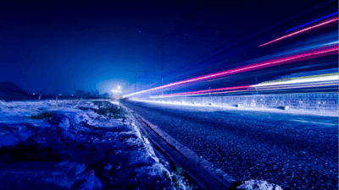
Just as displacement is made up of distance and direction, velocity is made up of speed and direction of motion.
The speed of an object is how fast the distance to the object is changing over time. Speed is a scalar.
The velocity of an object is how fast the displacement of the object is changing over time. Velocity is a vector.
Both speed and velocity are measured in metres per second (ms⁻¹).

Slide 5
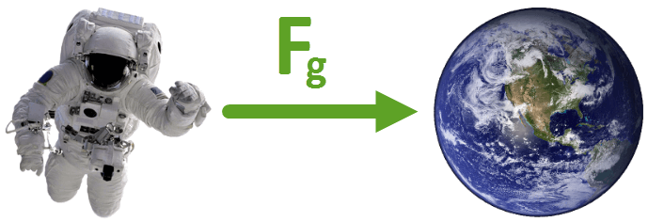
Speed is a scalar, which means it's described by a size only. Other examples of scalars are distance and mass. None of these quantities have a direction.
Velocity is a vector, which means it's described by a size and direction. Another example of a vector is the force of gravity, as it has a size (9.8 ms⁻²) and direction (toward the centre of the Earth).

Slide 6
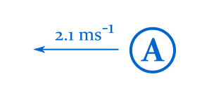
Example
What is the velocity of object A?

Slide 7
Solution
The velocity of object A is 2.1 ms⁻¹ to the left.
You must state both the size and direction of the vector.
We can see that the arrow extending from object A is pointing to the left, and that the label reads 2.1 ms⁻¹. This means that object A is travelling at 2.1 ms⁻¹ to the left.

Slide 8
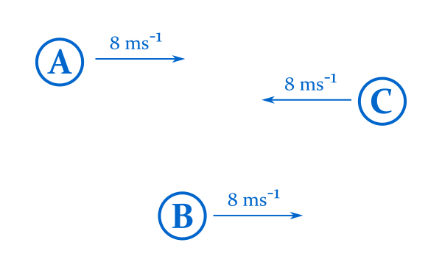
Here objects A, B, and C all have the same speed (8 ms⁻¹).
A and B have the same velocity (8 ms⁻¹ to the right) as they're travelling at the same speed, in the same direction.
The velocity of C is different (8 ms⁻¹ to the left) as it's travelling in a different direction.

Slide 9
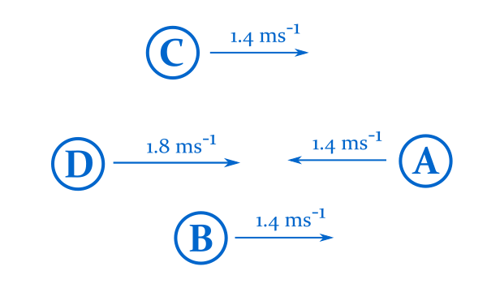
Example
Which two objects are travelling at the same velocity?

Slide 10
Solution
Objects B and C have the same velocity, 1.4 ms⁻¹ to the right.
A is travelling at the same speed, but in a different direction.
D is travelling in the same direction, but at a different speed.

Slide 11
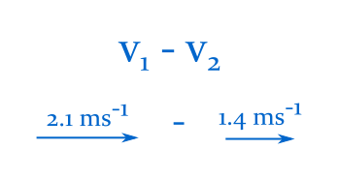
In this section we'll learn how to subtract vectors.

Slide 12
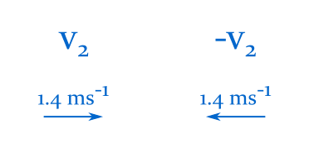
When subtracting numbers, taking away three is the same as adding negative three:
8−3=8+(−3)
Vectors work the same way. Subtracting a vector is the same as adding the negated vector:
v1​−v2​=v1​+(−v2​)
How do we find −v2​?
The negative of a vector is simply the vector with the same size, and opposite direction:

Slide 13
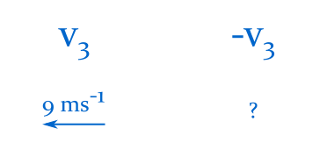
Example
What is the negative of the vector below?

Slide 14
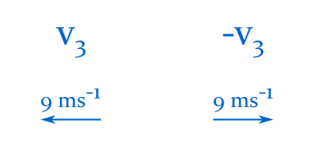
Solution
The negative of the vector below is 9 ms⁻¹ to the right.
The negative of a vector has the same size, and opposite direction.

Slide 15
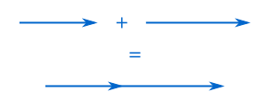
To subtract a vector from another, negate the subtracted vector, and add it to the other.
Adding two vectors together yields another vector, with a size and direction of its own.
Vectors are added by connecting the arrowhead of one vector to the tail of a second vector. The sum of the two vectors is the distance and direction from the tail of the first, to the tip of the second:

Slide 16
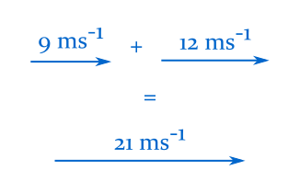
When two vectors are parallel and point in the same direction, calculate the new size by adding the two vectors together.
For example, in the image below the new vector is 21 ms−1 to the right.

Slide 17
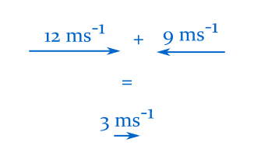
When two vectors are parallel and point in opposite directions, calculate the new size by subtracting the size of the smallest vector from the size of the largest vector.
The new direction is simply the direction of the largest vector.
For example, in the image below the new vector is 3 ms−1 to the right.

Slide 18

Example
What is the difference between the two vectors below?

Slide 19
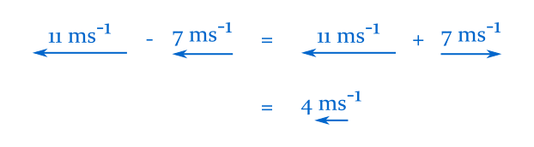
Solution
The difference between the two vectors is 4 ms−1 to the left.
Negate the second vector, then add it to the first:

Slide 20
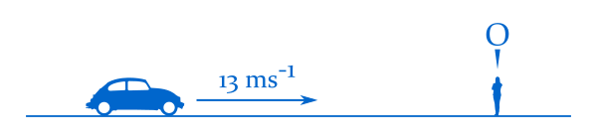
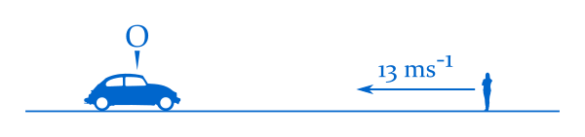
Until now we have always described speed and velocity relative to the ground. We always assume that the ground is not moving.
In real life, objects appear to move at different speeds depending on how fast you are moving.
From a pedestrian's perspective, cars look like they're moving past at high speed. From a motorist's perspective, pedestrians look like they're moving past the car.
In the diagram above, the pedestrian observes the car. In the diagram below, the car observes the pedestrian.

Slide 21
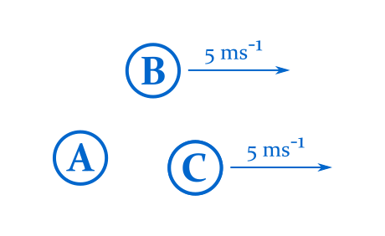
The diagram below depicts the velocities of a few objects relative to the ground.
The velocity of A is zero, and the velocities of B and C are 5 ms−1 to the right.

Slide 22
The velocity of an object looks different depending on where it is measured from. Let's observe the relative velocity of some of the objects below.
Relative to object A, object B is moving at 5 ms−1 to the right.
This is quite natural. Object A isn't moving, and object B is. Of course object A sees object B in motion.

Slide 23
Objects B and C have the same velocity. As time progresses, objects B and C will continue to move side by side, and not get any closer or further away from each other.
Relative to object C, object B is not moving.

Slide 24
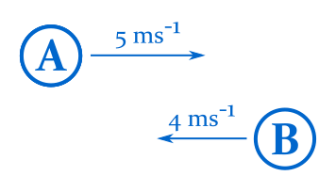
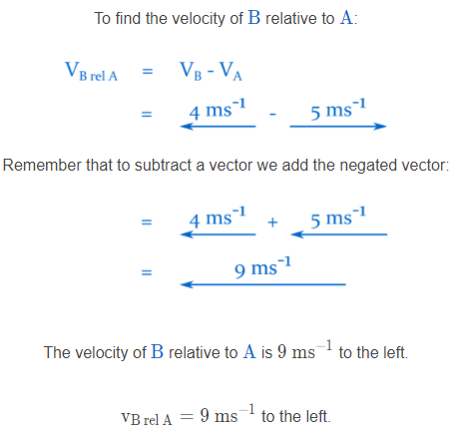
Let's look at two new objects that are moving in opposite directions:
To find the velocity of an object relative to another, subtract the velocity of the observer from that of the observed object.

Slide 25
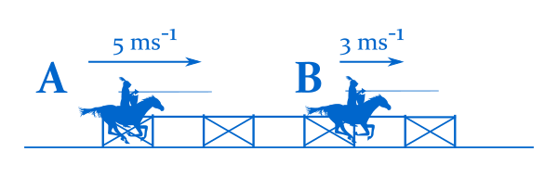
Example
Two knights are practising their jousting runs.
Knight A is travelling at 5 ms−1 to the right, and knight B is travelling at 3 ms−1 in the same direction.
What is the velocity of knight B relative to knight A?

Slide 26
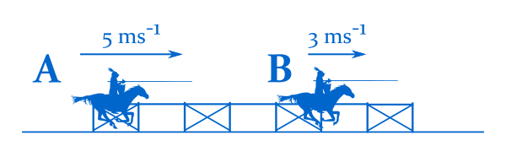
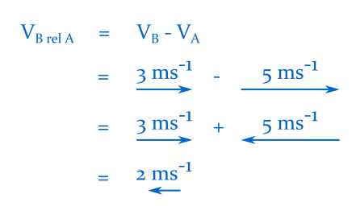
Solution
To find the velocity of an object relative to another, subtract the velocity of the observer from that of the observed object.
To find the velocity of B relative to A:
The velocity of knight B relative to knight A is 2 ms−1 to the left.

Slide 27
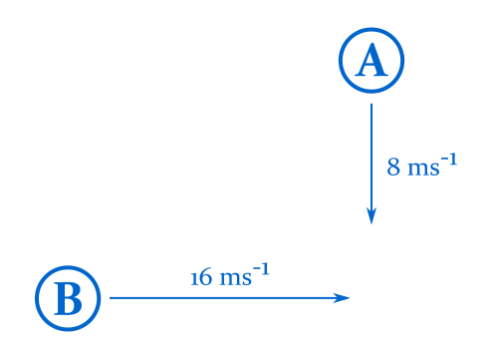
In this section we'll learn how to calculate relative velocity in two dimensions.

Slide 28
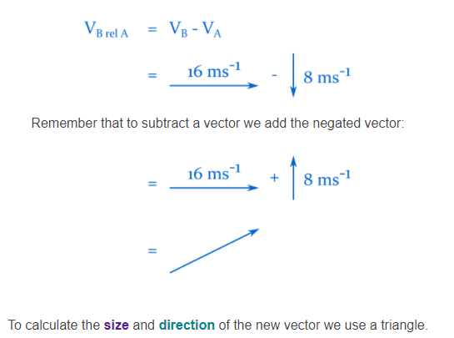
Just as for one dimension, to find relative velocity in two dimensions, subtract the velocity of the observer from the velocity of the observed object.

Slide 29
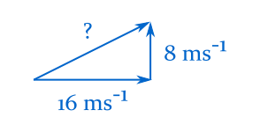
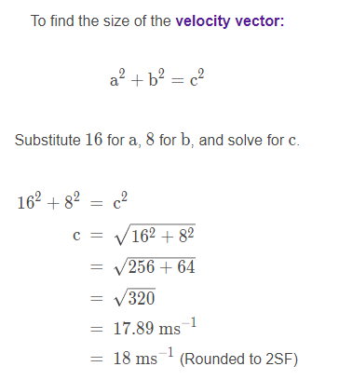
To find the size of the velocity vector we use Pythagoras' theorem.

Slide 30
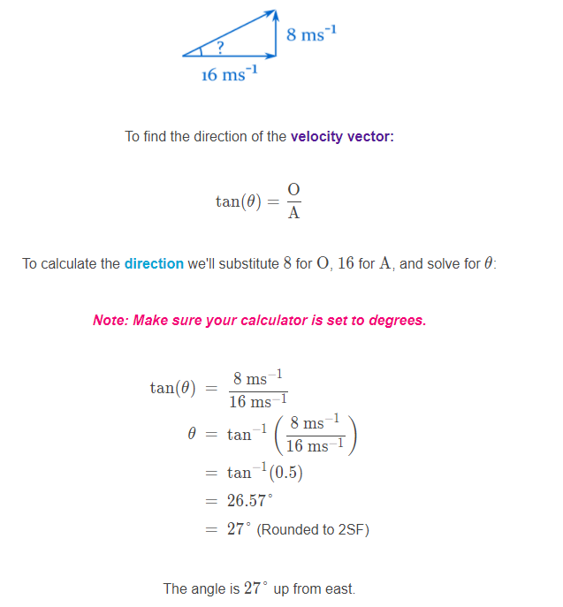
Now that we have found the relative velocity vector, we can calculate the direction of the vector with trigonometry.

Slide 31
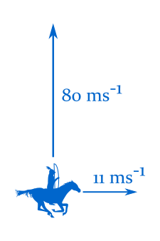
Example
An archer on horseback rides east across the field at 11 ms−1.
She fires an arrow at a target to the north. The arrow travels at 80 ms−1.
What is the velocity of the arrow relative to the ground?

Slide 32
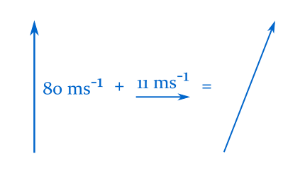
Solution
As the arrow is fired from an object that's moving relative to the ground, the arrow's velocity relative to the ground is the sum of the two velocities.

Slide 33
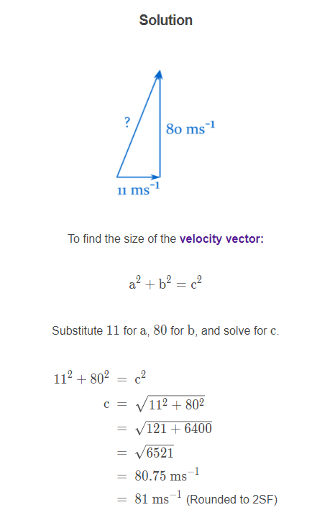

Slide 34
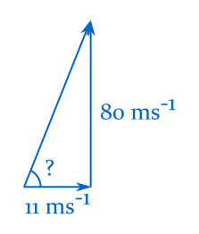
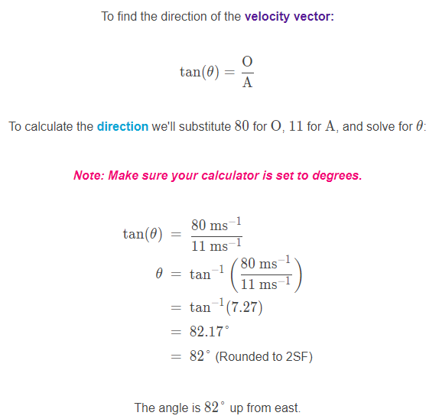
Solution

